Slide 1


IMPLEMENTING VIRTUAL ASSISTANT USING CNN FOR TRAVEL PLANNER
UNDER THE GUIDANCE OF
Dr. D Santhosh Kumar
Assistant Professor, ECE
VNRVJIET
PRESENTED BY: Batch-15, ECE-4
G VAMSHIDHAR - 17071A04K5
N RAJESH - 17071A04M5
RAM PENTAPATI - 17071A04N1
P PAVAN KUMAR - 18075A05445

Slide 2


Introduction
In the modern world, We know that Everything is Online and Digitalized.
Digital Process is new to many people, They have of lot of queries related to working of applications. Organizations hire people for customer support but increasing no of customers, customer support/executive are unable to handle hundreds of people at a time.
So most of the people’s queries remained unsolved.
Here comes Virtual Assistant into picture.

Slide 3
Problem statement
Organisations are spending huge amount on customer support, Customer Service and still unable to resolve all the queries of Users efficiently.
Virtual Assistant would reduce the amount spent, work pressure on Customer Support and also enhances User experience.

Slide 4
objectives OF THE PROJECT
OBJECTIVE 1
OBJECTIVE 2
OBJECTIVE 3
INPUT
(SPEECH OR TEXT)
OUTPUT
(SPEECH AND TEXT)
INTEGRATING WITH
WEB-APPLICATION

Slide 5


OBJECTIVE 1: To enable user input
Our Virtual Assistant will be accepting the input as text or speech, To accept speech as input we will be using system microphone, Speech recognition (Python Library).
Later using Speech-to-Text conversion technique (Provided by Speech recognition library), Speech input is converted into text and processed.

Slide 6


OBJECTIVE 2: TO DISPLAY output (text or speech)
Output will be displayed based on user input. When user enters the place name CNN model checks with the data-set and compares the input with intents and fetches the matching result as output.

Slide 7
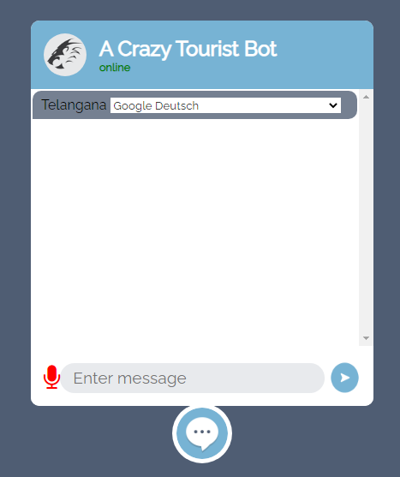




Objective 3: To integrate model with web-application
We built web-application using HTML,CSS, Java Script, Angular UI framework and using the Flask integrated our model with web-application.

Slide 8
LITERATURE SURVEY
S.NO | NAME OF THE JOURNAL | YEAR | NAME OF THE AUTHORS | WORK CONTRIBUTED | REMARKS
1 | Critical Literature Review on Chatbots in Education (IJTSRD) | 2020 | Hephzibah Thomas | This paper focuses on text input and text output . And also this paper talks about usage of chat-bots in educational fields. | This paper only uses text to text . Using speech to speech and text to text or text to speech would be much better.
2 | Implementation of Virtual Assistant with Sign Language using Deep Learning and Tensor Flow | 2021 | Vani Valsaraj | This project converts sign language to text using deep learning and tensor flow. | This is explicitly useful for deaf and dumb. If output is in text, output in speech would be better.
3 | Jarvis - A Virtual Assistant based on Artificial Intelligence | 2020 | Dr.M. Sharada Varalakshmi, Dr.P. Lavanya | This paper talks about speech recognition approach. | This paper explained about approach of Speech recognition.
4 | A Review Paper on Smart Personal Assistant | 2016 | Yogendra Kumar Sharma Neeraj Sharma | This Paper talks about overview of applications of Smart Personal Assistant in various fields. | They didn’t explained about any architecture gave a brief on Smart Personal Assistant.

Slide 9
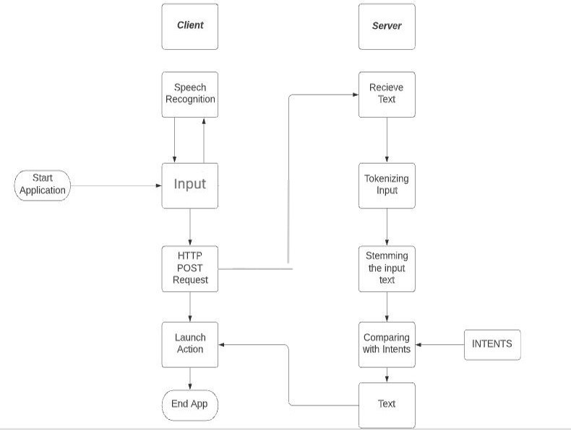
BLOCK DIAGRAM of the project

Slide 10
METHODOLGY AND WORK FLOW
Input:
User gives input to the model using web page. User can enter the input in the field.
Speech Recognition:
User can enter input in text or voice. If user enter voice as input. Speech synthesis library detects the voice and converts into text for processing.
HTTP POST Request:
HTTP stands for “Hypertext transfer protocol”. After Speech input is converted to text. Client raises a request to server using HTTP POST Request.
Receive text:
Server receives text from client. Server consists of model which processes the input and sends the output to Client. To get output there are some steps to be followed.

Slide 11
METHODOLGY AND WORK FLOW
Tokenizing Input:
Model uses NLP for tokenizing input. It is the process which converts sentences into tokens.
Stemming Input:
Model uses NLP for stemming the input. It is the process which converts words into base or root form.

Slide 12
METHODOLGY AND WORK FLOW
Comparing the intents:
After tokenization and stemming the input next step is comparing the input with the intents present in the dataset and CNN algorithm tracks for the matching result.
Sample dataset:
{
“tag”: ”tag_name”
“patterns”: [”pattern_name”]
“responses”: [“Response”]
}

Slide 13
METHODOLGY AND WORK FLOW
Text:
Once matching result is fetched, now model will send the output to Client which sent Response to the HTTP POST Request.
Launch Action:
Client receives output from Server. Now client which is web page displays the output to the user. If user input is text voice output will be text. If user input is voice/speech, output will be in speech.

Slide 14
SOFTWAREs and tools used
Python
PANDAS
NUMPY
Speech Recognition
Natural Language Processing (NLP)
Convolutional Neural Network (CNN)
HTML, CSS, JavaScript, Angular
Tools Used:
Google Collab.
Vs CODE
Python IDLE

Slide 15
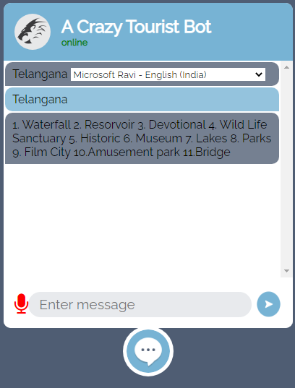
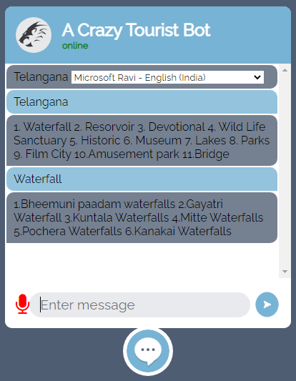
SNAP SHOT OF THE RESULT

Slide 16
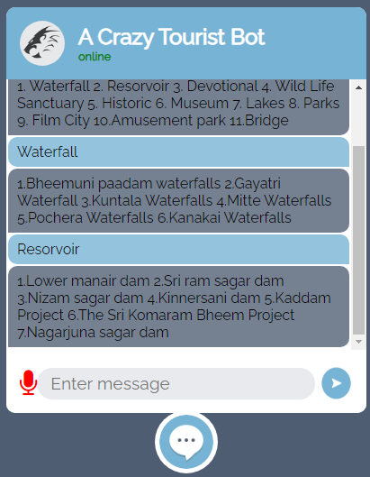
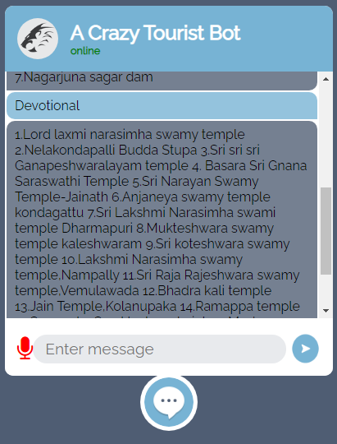
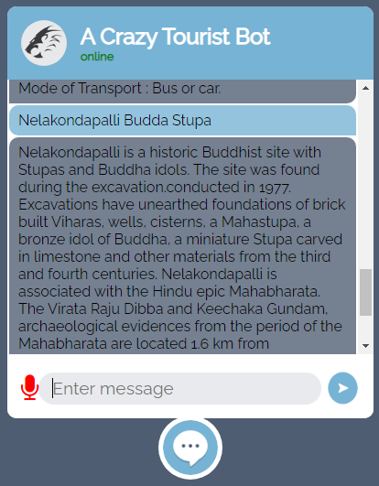
SNAP SHOT OF THE RESULT

Slide 17
RESULT
Input to Output | RS1 | RS2 | RS3 | LATENCY
Text to Text | 0.018ms | 0.015ms | 0.019ms | 0.00971ms
Speech to Speech | 0.018ms | 0.015ms | 0.019ms | 0.00977ms
RESPONSE TIME: 0.0173ms
LATENCY: 0.00974ms

Slide 18
CONCLUSION
Virtual Assistant reduces human effort by responding to the queries asked by users. When Virtual Assistant is powered by a deep learning algorithm called Convolutional Neural Network it gives a good response.
CNN model is trained with a data-set consisting of 87 most visited places in Telangana whenever a user enters the place name our model processes the data and fetches the result from the data-set.

Slide 19
Future scope
By Adding the Images and Videos of the respective places, We can enhance the user experience.
Sentiment Analysis can also added to enhance User Experience.
Using the API of Google maps, we can integrate maps with our model and we can show directions and review of the places on our webpage itself.
This can also be used for educational purposes, entertainment purposes.

Slide 20
applications
E COMMERCE CINEMA MEDICAL ONLINE GROCERY

Slide 21
ROLES AND RESPONSIBILITIES
S.NO | NAME OF THE STUDENT | ROLES AND RESPONSIBILTIES
1 | G VAMSHIDHAR(4K5) | Implementation, Debugging, Training and Testing.
2 | N RAJESH(4M5) | Data Collection and Manipulation
3 | RAM PENTAPATI(4N1) | Implementation, Research, Documentation, Training and Testing,
4 | P PAVAN KUMAR(445) | Research, Data Collection and Manipulation.

Slide 22
references
[1] Dr. M. Sharada Varalakshmi, Jarvis - A Virtual Assistant based on Artificial Intelligence, International Journal of Grid and Distributed Computing Vol. 13, No. 2, (2020), pp. 776 – 784
[2] Yogendra Kumar Shar m a , A Review Paper on Smart Personal Assistant, International Journal of Engineering Research & Technology (IJERT) ISSN: 2278-0181 Published by, www.ijert.org V-IMPACT - 2016_2 Conference Proceedings
[3] Hephzibah Thomas , Critical Literature Review on Chatbots in Education , International Journal of Trend in Scientific Research and Development (IJTSRD) Volume 4 Issue 6, September-October 2020 Available Online: www.ijtsrd.com e-ISSN: 2456 – 6470
[4] Vani Valsaraj, Implementation of Virtual Assistant with Sign Language using Deep Learning and TensorFlow, International Journal for Research in Applied Science & Engineering Technology (IJRASET) ISSN: 2321-9653; IC Value: 45.98; SJ Impact Factor: 7.429 Volume 9 Issue I Jan 2021- Available at www.ijraset.com

Slide 23
references
[5] The Alexafication of Adult Social Care: Virtual Assistants and the Changing Role of Local Government in England, International Journal of Environmental Research and Public Health
[6] Nanaware, Rasika. “Chatbot for Education System.”, Corpus ID: 58318311, (2018).
[7] Clarizia F., Colace F., Lombardi M., Pascale F., Santaniello D. (2018) Chatbot: An Education Support System for Student .

Slide 24
Thank you
BATCH-15

